Slide 1
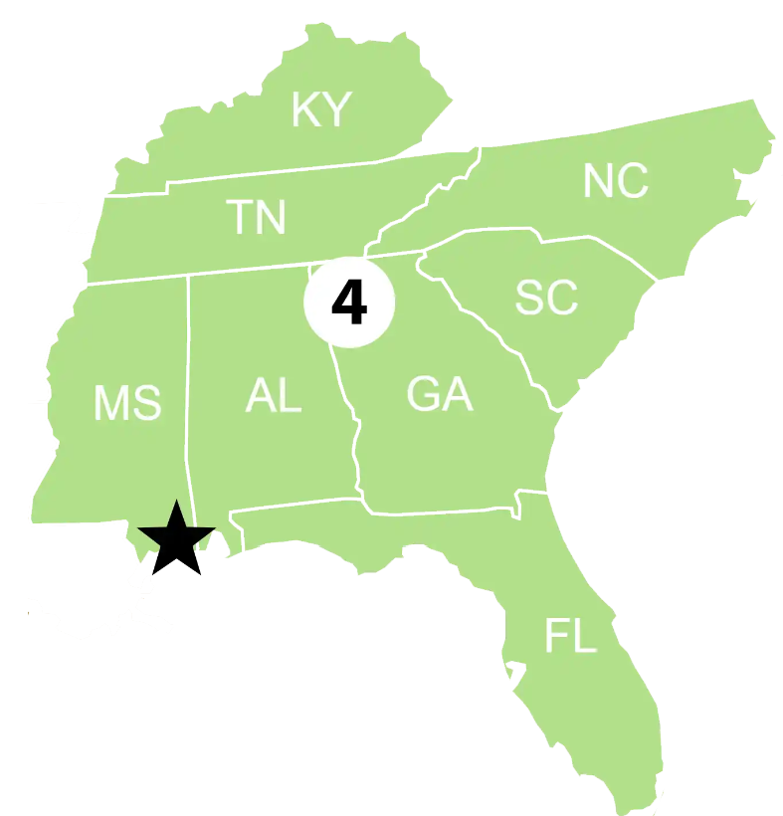

Sector North Carolina
Federalized cases:
S/V MYSTIC LADY F/V CLAIRE SKYE
P/C NC7084WU F/V REEL TEASE
P/C KEINE EILE P/C POPS YACHT
Notable cases or engagements:
- F/V CLAIRE SKYE and F/V DAISY LEE
- ESF-10 TTX
3 biggest RRT-related concerns in your AOR:
1. Abandoned/derelict vessel; disposal concerns
2. Information sharing between agencies in post-storm assessment
3. Post storm access to remote/ isolated communities
Notes:
F/V CLAIRE SKYE aground Surf City, NC, 600 gals of diesel o/b; OSLTF $30K
F/V DAISY LEE aground, 25 gals diesel o/b

